Slide 1


Adaptive Quiz Application - Adaptq
A JAVA-BASED PERSONALIZATION QUIZ PLATFORM
Group B1G3:
  Daniel Fernandes - 2615
  Akash Bhatt - 2607

Slide 2

Introduction
Problem
  Traditional quiz systems often provide the same level of difficulty to every learner.
  A score alone does not clearly indicate which topics need improvement.
  Students need a more personalized way to practice, evaluate, and improve their knowledge.
Project Overview
  A Java-based quiz application that adapts question difficulty based on user performance.
  Questions are organized by subject, topic, and difficulty level.
  Users can take quizzes and receive score and topic-wise performance results.
  The system helps users identify areas where they need more practice.

Slide 3
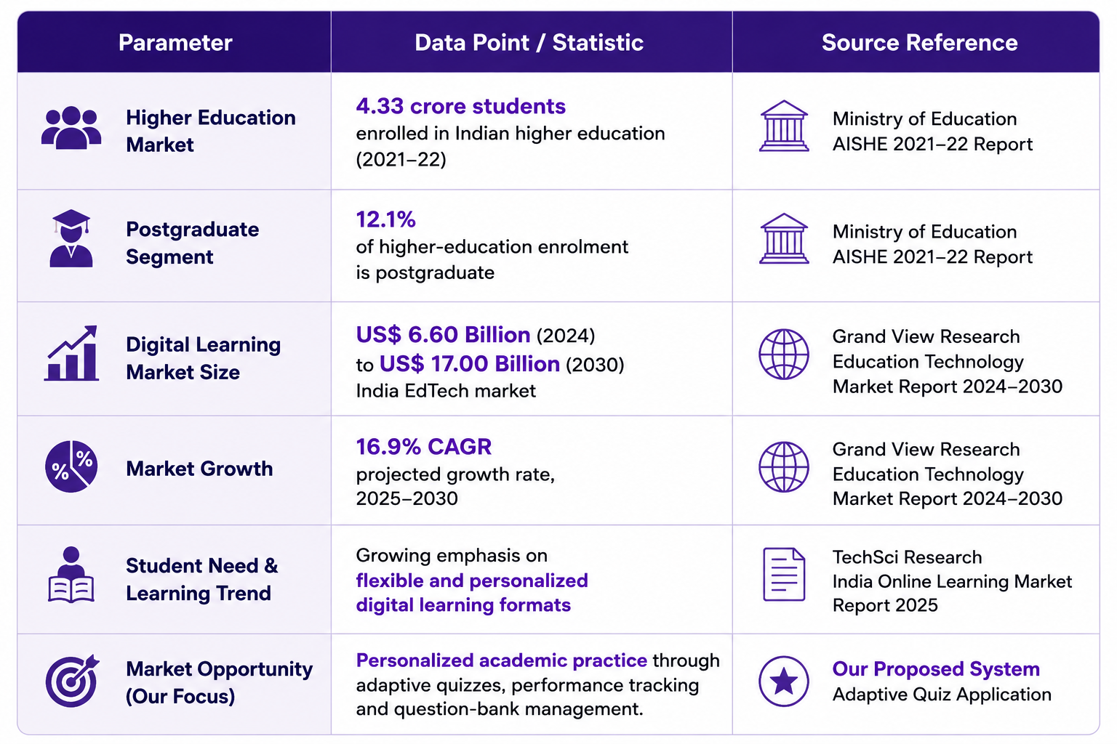
market analysis

Slide 4
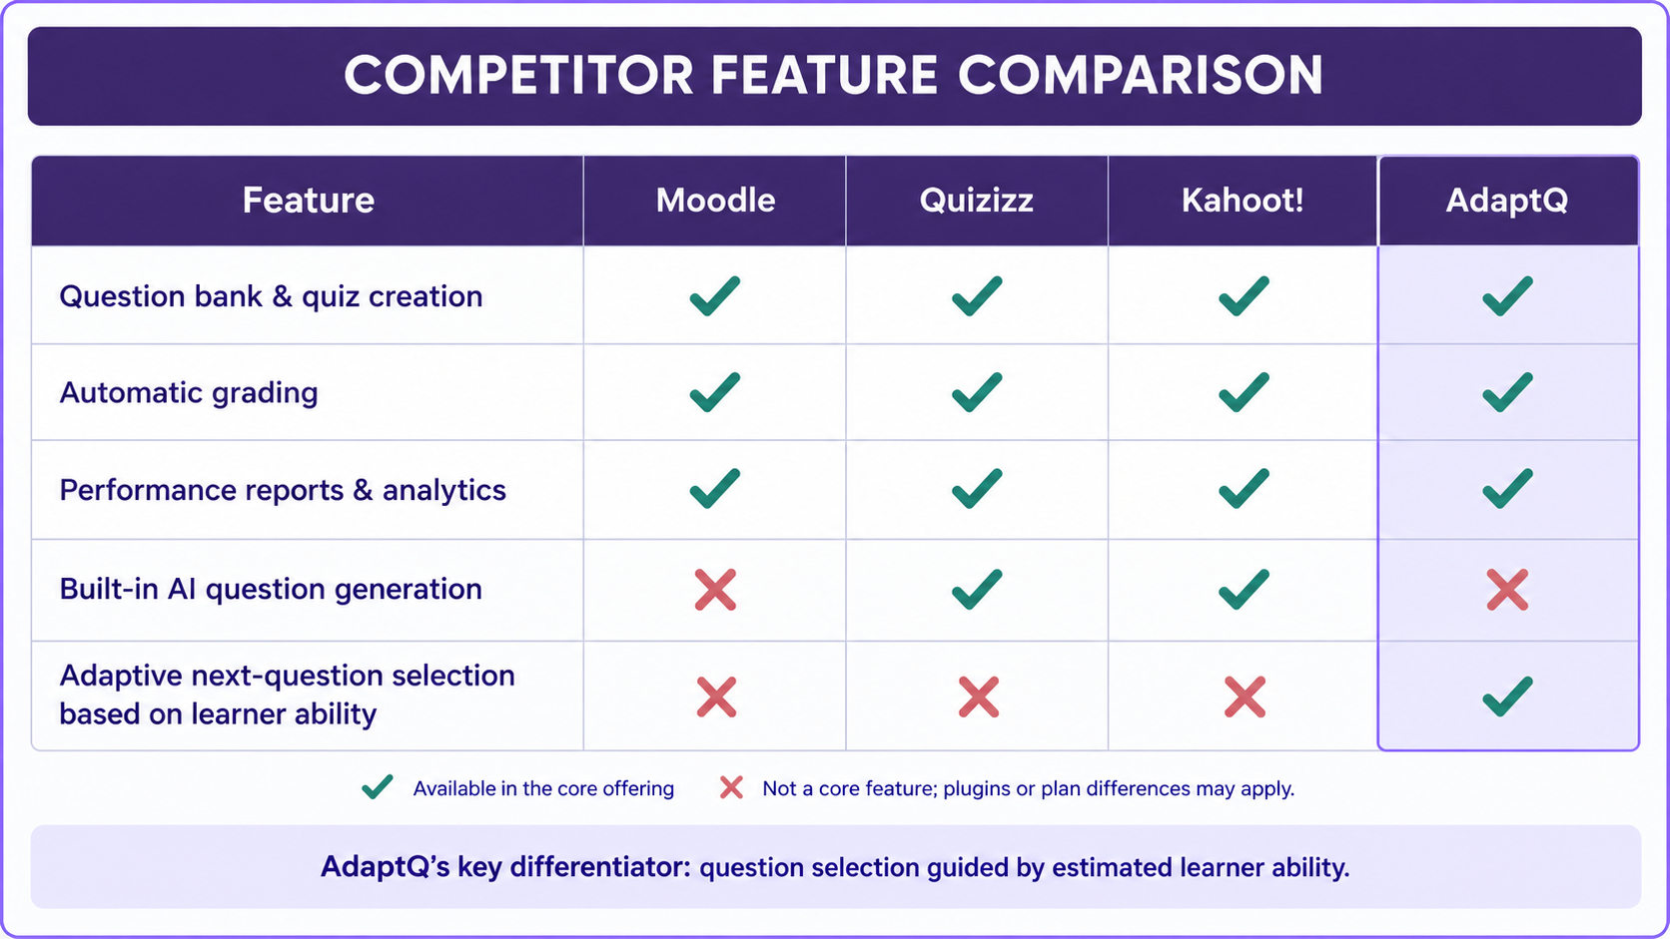
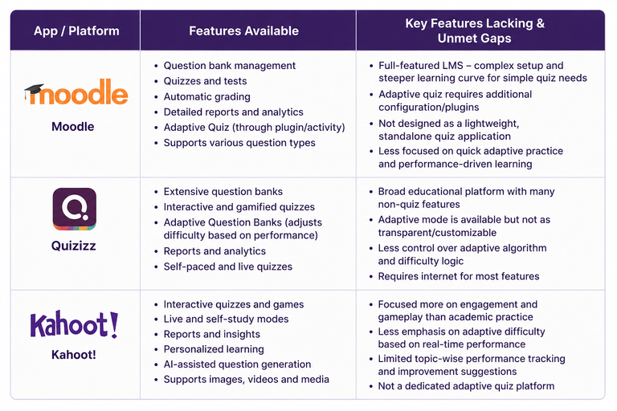
Competitor analysis

Slide 5

PROJECT OBJECTIVES
  To develop a quiz application that adjusts question difficulty based on learner performance.’
  To provide subject-wise and topic-wise practice across different computing subjects.
  To track quiz performance and help learners identify areas where they need improvement.
  To improve question selection based on learner responses and estimated ability.

Slide 6

HOW THE ADAPTIVE ALGORITHM WORKS
Question Selection
The system estimates learner ability and selects a question of suitable difficulty.
Response Analysis
The system records answer correctness and response time.
Adaptive Calibration
The engine updates learner ability and question difficulty estimates based on the response.
Next Question
The updated estimates guide the selection of a suitable question for the next attempt.

Slide 7

TECHNOLOGY STACK
  Frontend: HTML, CSS and JavaScript for the student interface and Admin Dashboard.
  Backend: Java and Spring Boot for application logic, quiz management, and adaptive question selection.
  Database: H2 for storing user information, questions, responses, and quiz attempts.
  Data Access: Spring Data JPA and Hibernate for database operations.
  Build Tool: Apache Maven for dependency management and building the application.

Slide 8

Key Features
Adaptive Practice
Adjusts question difficulty based on learner performance.
Time Attack
Allows learners to answer questions in a timed challenge.
XP & Achievements
Rewards learner activity and progress through experience points and achievements.
Performance Analytics
Displays learner performance, subject mastery, and response-time data.
Question Health
Helps administrators monitor question quality and identify potential issues.

Slide 9

proposed revenue model
Free Plan
  Adaptive Practice — Quizzes that adjust to learner performance.
  XP & Achievements — Rewards for practice and progress.
  Basic Performance Tracking — View quiz scores and accuracy.
Premium Plan — Proposed ₹49/month
  Time Attack — Timed quiz challenges.
  Detailed Performance Analytics — Deeper insights into results and response times.
  Question Insights — Explore question difficulty and identify potential issues.
Institutional Plan — Future Proposal
  College Partnerships — Sell AdaptQ to colleges and educational institutions.

Slide 10
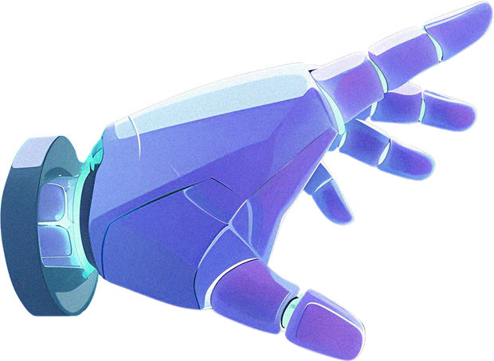
FUTURE ENHANCEMENTS
  Improved Question Management — Make adding, editing, and reviewing questions easier for administrators.
  Refined Adaptive Algorithm — Improve how the system selects questions based on learner performance.
  Learner Progress History — Let learners track past attempts and identify weaker topics.
  AI-Assisted Question Generation — Help administrators generate draft questions and explanations for review.

Slide 11

thank you
26 october 2026

